Slide 1

Application: ParkEz Type: Application Architecture View: Logical View Style: Layered Architecture Pattern
Users
Delivery Channels
Core Business Processes
Data And Information
Technology Enablers
Count Cars
User Information
Connection for Database (Postgresql)
Subscribed Parking Lot Operators
Track Plates
Ad Metrics
Lot Footage (HTTP HLS)
Customer Support Specialist
Get Best Space
Ad Content
User Interface (React)
Car Parking Users
Browser
Find Over parkers
Camera Feed
Application Hosting Server (Vercel)
Place Ads
Saved footage
Subscribed Advertisers
Github & Delivery Pipeline
View Footage
Lot Data
Accountant
Access Old Footage
Support Requests
ML Space Recognition (PyTorch)
Ad & Sales Rep
Request Support
Payment Data
Payment Process System
Manager

Slide 2
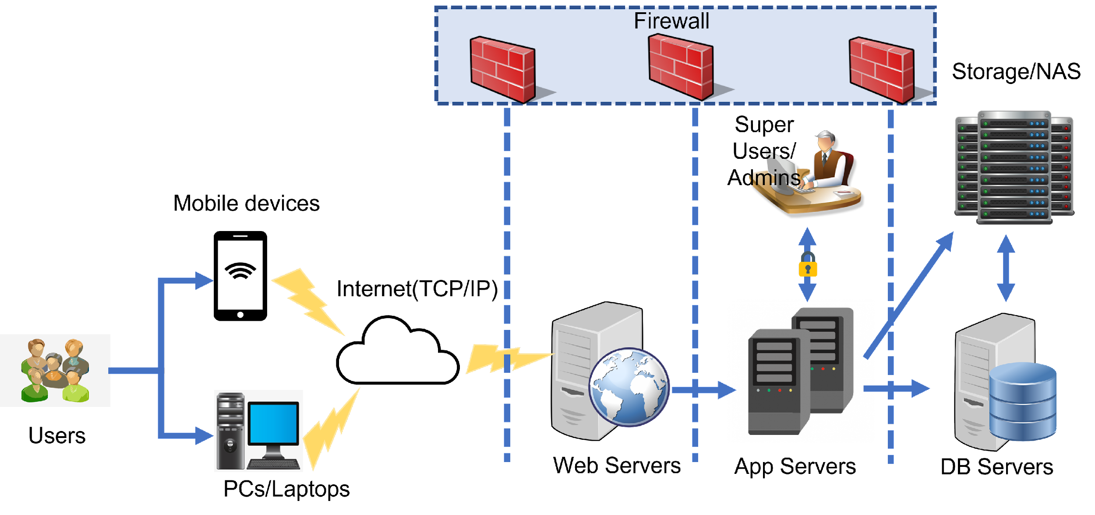

Application: ParkEz Type: Application Architecture View: Process View Style: Client-Server Pattern
Lot Camera feed
Machine Learning Server

Slide 3










ParkEz WebApp Type: Application Architecture View: Physical View Style: Layered Architecture Pattern
Venders
Application Layer
(many data centers, many server models) Stripe Servers
Internet
(AMD Ryzen 5 4500
NVIDIA GPU GeForce MX350
Gunicorn, Nginx, PyTorch Server)
Firewall
ML Server
External Layer
(Amazon AWS data centers, Linux VPS) Nginx and Uvicorn Server
(generic hardware models)
(Netgear R6700) Router
Router
Internal Layer
(generic hardware models)
Lot Cam & Plate Reader
PC
Mobile
Router
PC
User
Engineers / Employees
Admin

